Slide 1
SC1015 Mini-Project : Optimizing Movie Revenue
U2122520H Eldrian Koh
U2121033B Ian Lai
U2120934G Kavita Sriram
Notes:
Hello everyone welcome to our, lab group SC8 team 7, sc1015 mini project titled optimizing movie revenue

Slide 2
INTRODUCTION
01

Slide 3
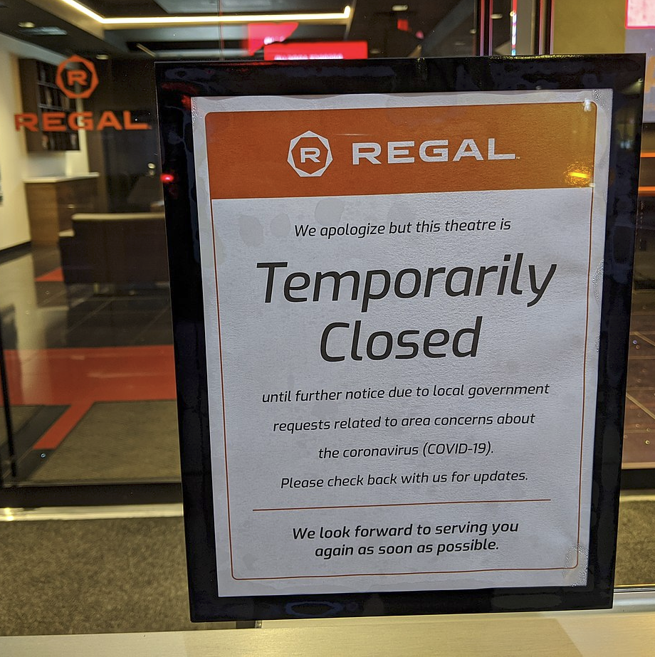



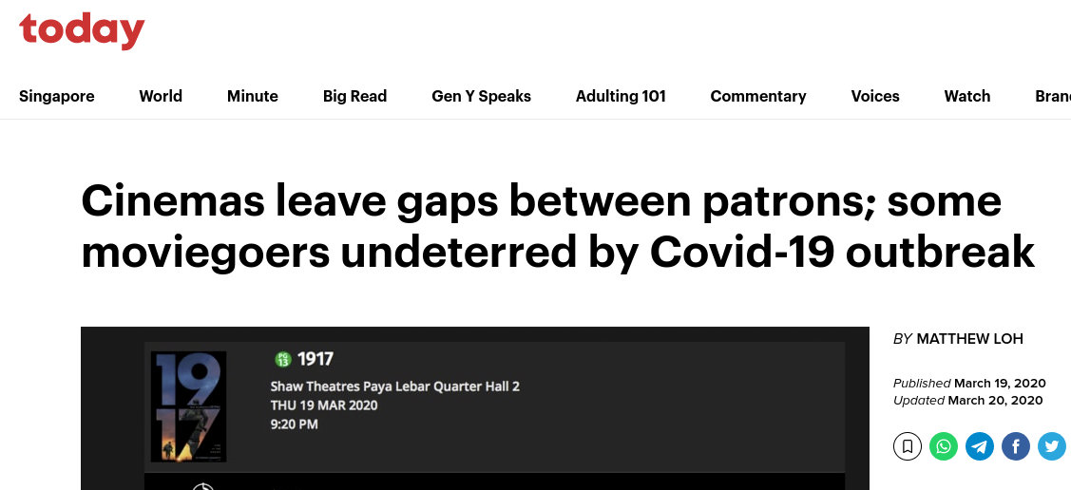
ISSUE
COVID-19
Notes:
As we all know, COVID-19 has cause significant impact to our society for the past 2-3 years, this is especially true for the film industry. As you can see on the right side, cinemas were closed to prevent the spread of the virus and today requires patrons to leave gaps between each other reducing the potential earnings for a particular screening.

Slide 4

PROBLEM STATEMENT
How can movie producers maximise their profit?
Notes:
So how can movie producers maximise their profit

Slide 5
PROBLEM DEFINITION
How do different variables affect the revenue of a movie?
Notes:
This leads us to our problem definition, how do different variables affect the revenue of a movie?

Slide 6
DATASET
02

Slide 7
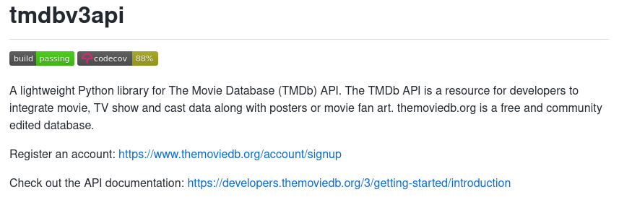
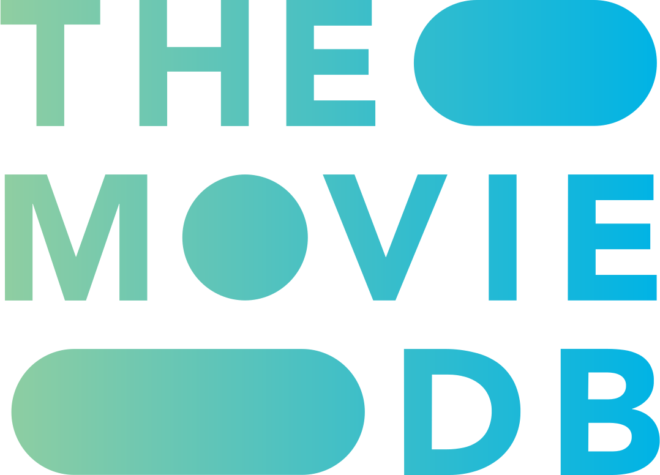
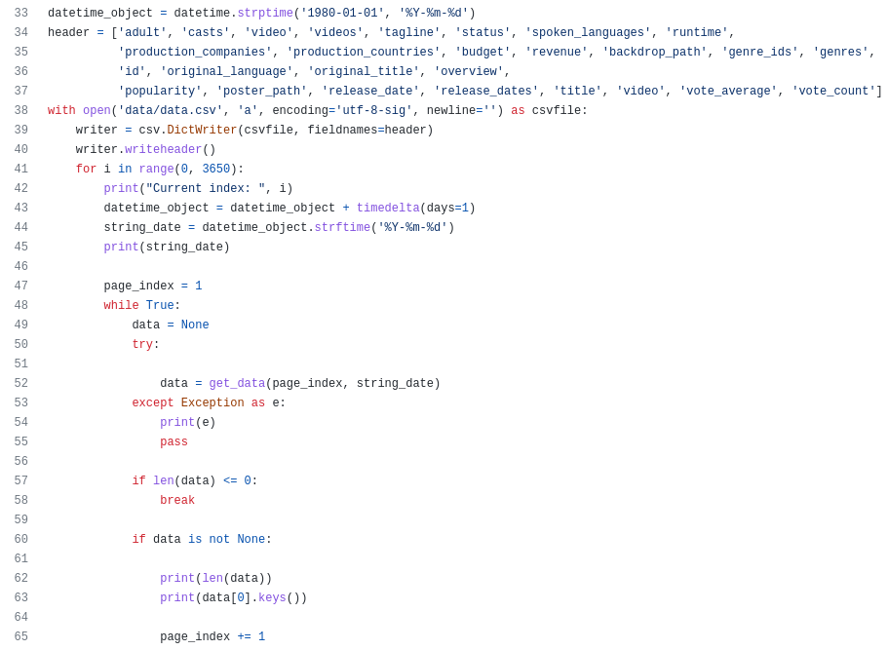
DATA EXTRACTION
Notes:
Our data was extracted from the movie database website using a lightweight python library to access it's API and a custom python script to export

Slide 8
DATA EXTRACTION
API
CSV
Notes:
The api into a csv file. Before we cleaned the data, we realised that many of the fields had additional commas which messed up the csv line separators. We fixed it by replacing the commas before it was exported as a csv file.

Slide 9
DATA CLEANING

Slide 10
Adult | Budget | Production Countries
Casts | Revenue | Popularity
Video | Backdrop Path | Poster Path
Videos | Genre ids | Release date
Tagline | Genres | Release dates
Status | id | Title
Spoken Languages | Original Language | Video
Runtime | Original Title | Vote Average
Production Companies | Overview | Vote Count
Release date | Production Countries | Production Companies
Budget | Original Language | Spoken Languages
Revenue | Casts | Popularity
Genres | Runtime
Notes:
Upon receiving the correctly formatted csv file, we removed the unnecessary variables such as ids and paths to form our concise dataset.

Slide 11
DATA CLEANING
DROP ROWS
REMOVE NULL
REMOVE OUTLIERS
REMOVE DUPLICATES
when data contains a NULL value
when budget or revenue is 0
when rows are identical
based on revenue
Notes:
Additionally, we also did some data cleaning, removing the null value, drop the rows when budget or revenue is 0, removing the duplicates and removing outlier to present the data more accurately.

Slide 12
EXPLORATORY
DATA ANALYSIS
03

Slide 13
Variables
Release date
Genre
Runtime
Popularity
Cast
Notes:
So far, we have explored several variables from the dataset. The team ultimately decided to focus on the following variables to see how they would affect the revenue of a movie.
In the notebook, we have done in depth analysis on all of these variables. However, in this presentation, we will only briefly go through the variables and show what they entail

Slide 14
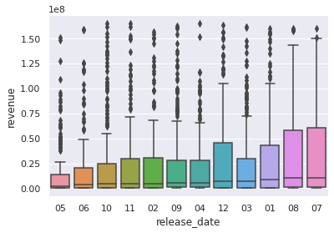
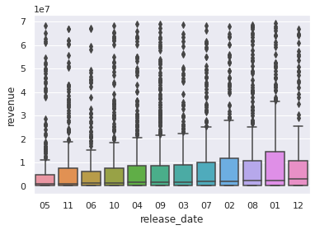
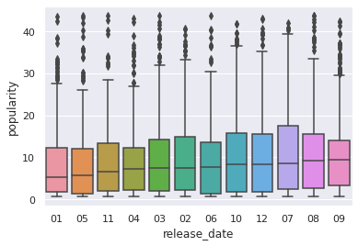
Release Date
May as a release month has lowest revenue.
July as a release month has highest revenue.
Notes:
First up is release date and revenue. We see that the May: 05, as a release month, has the lowest median or lowest revenue. It is January, August, and July, that have higher medians or higher revenue, with July having highest revenue.

Slide 15
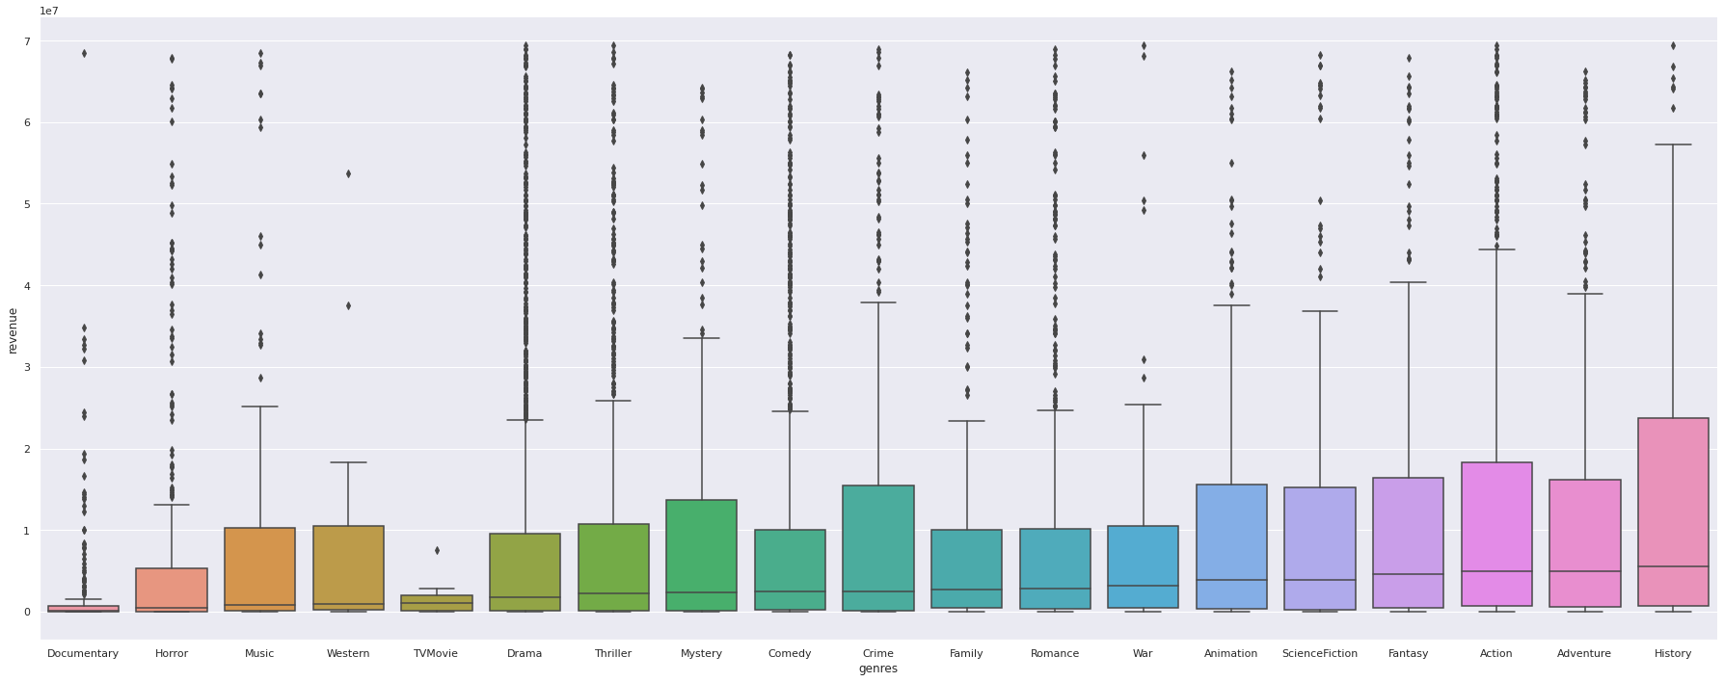
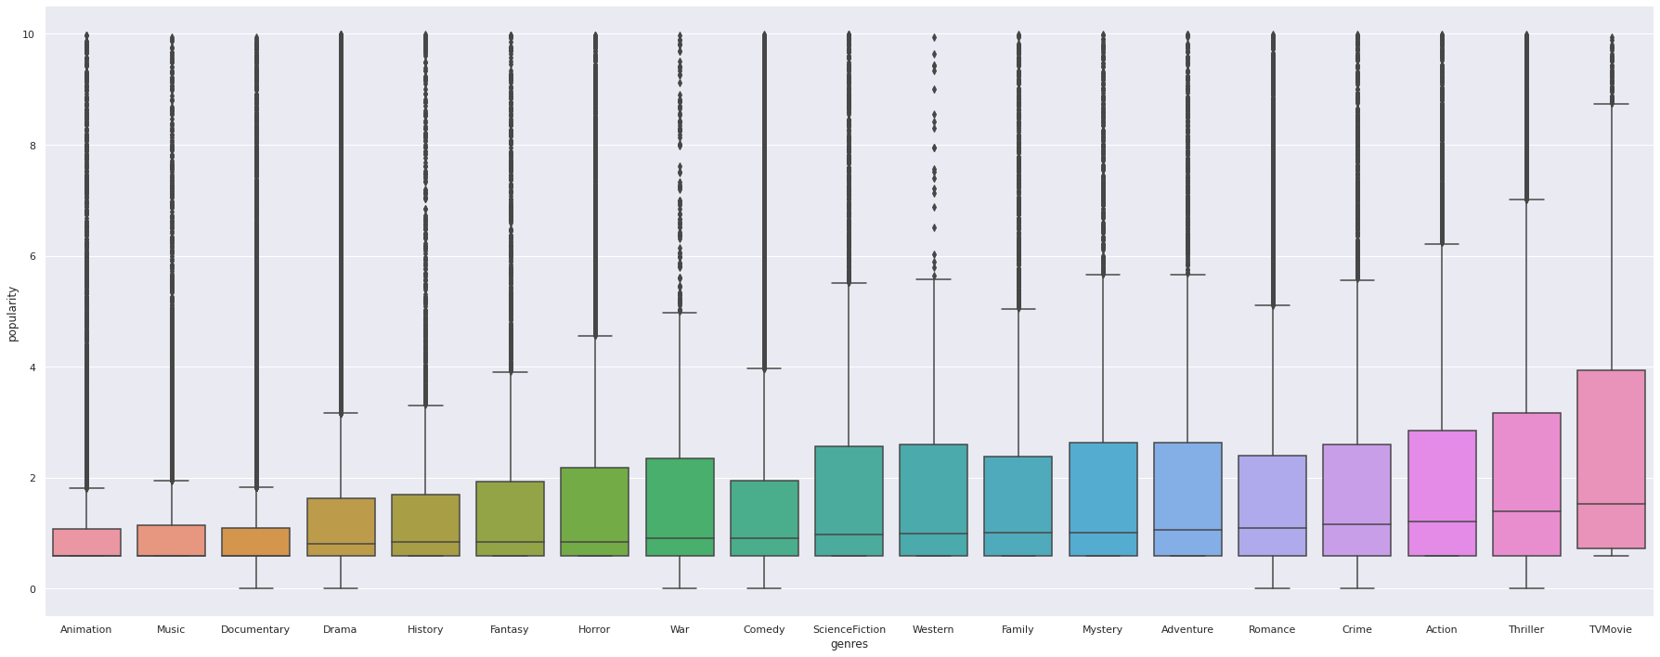
Genre
Summary
‘Documentary’, ‘Horror’, and ‘Music’ have lower revenue.
‘Fantasy’ , ‘Action’, ‘Adventure’, and ‘History’ have higher medians or higher revenue.
Notes:
Moving on we will compare genre and revenue. We see in this boxplot graph where we compare the median, that genres such as ‘Documentary’, ‘Horror’, and ‘Music’ have lowest medians and therefore the lowest revenue.
After which, medians of almost all genres up till ‘Science Fiction’ have around the same median or same revenue, it is ‘Fantasy’ , ‘Action’, ‘Adventure’, and ‘History’ which have higher revenue.
The ‘History’ genre has highest revenue among all the genres.

Slide 16
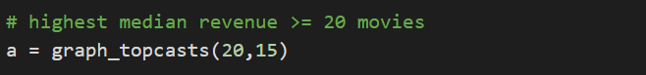
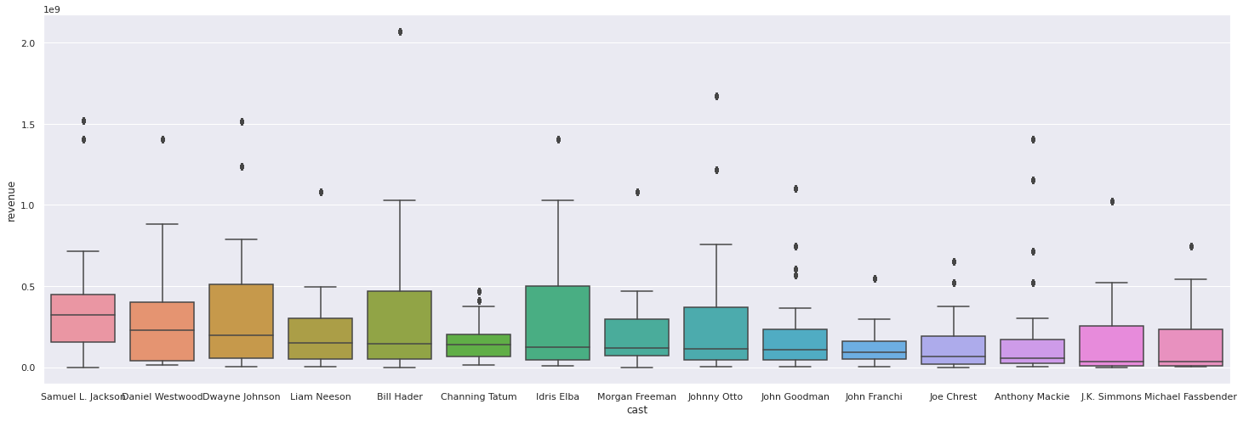
Cast
Summary
X axis: 15 actors who have consistently performed well with 20 movies, Y axis: Revenue
Samuel L. Jackson brings in the greatest revenue.
Notes:
The cast of a film is also an important variable that affects revenue. This plot compares revenue with 15 accomplished actors who have consistently performed well with 20 movies.
We observe that having Samuel L. Jackson in the cast of a movie brings the greatest revenue, followed by Daniel Westwood and Dwayne Johnson.

Slide 17
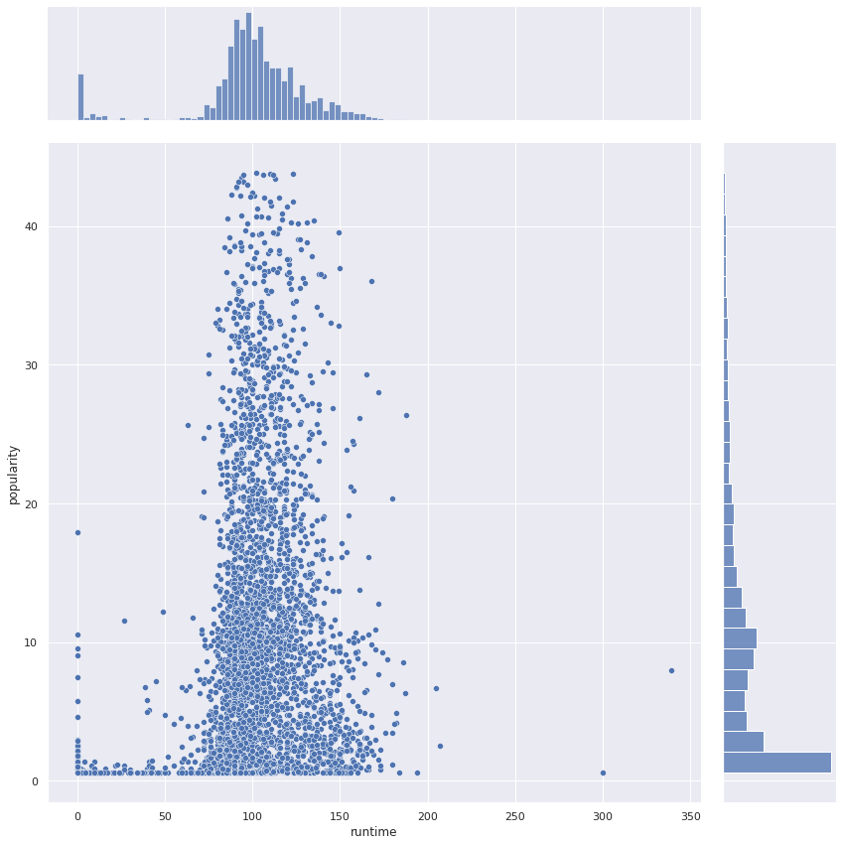
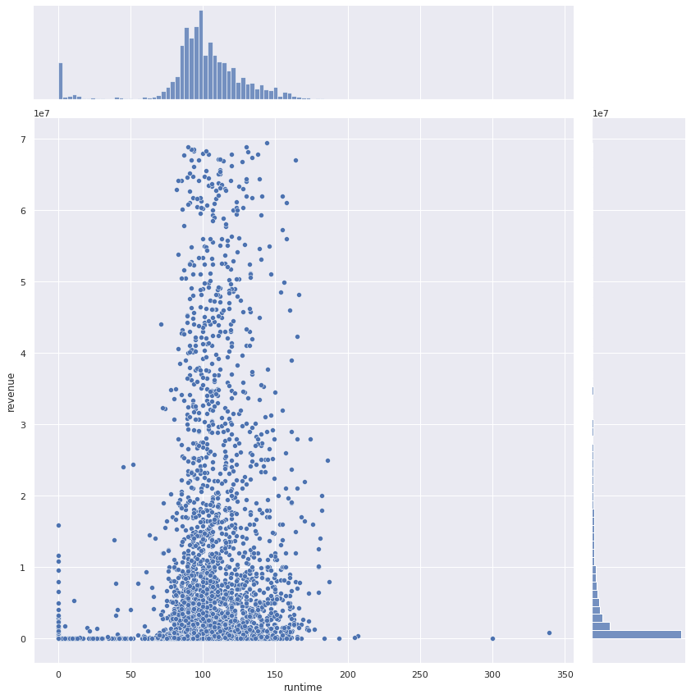
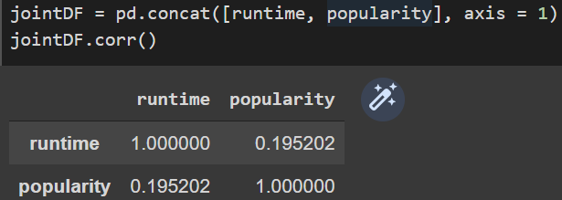
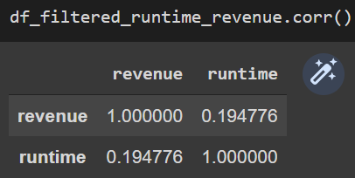
Runtime
Not much linear correlation between runtime and revenue.
High revenue for runtime between 50-150 minutes.
Notes:
In this comparison, we see that there is little to no linear correlation between runtime and revenue, but we notice that the revenue is high when runtime is between 50-150 minutes.

Slide 18
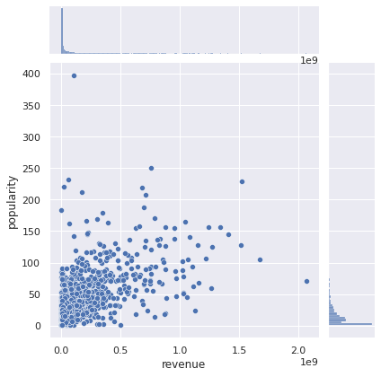
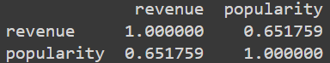
Popularity
Moderately Strong Linear Correlation of around 0.65
Notes:
Lastly, from this jointplot, we notice that the popularity of a movie has a moderately strong correlation with the revenue. In the end, from the Exploratory Data Analysis, we can see multiple correlation between other variables and revenue. Hence, this variables can be used to predict the revenue of movie which leads us to our machine learning models.

Slide 19
MACHINE LEARNING
04

Slide 20
Models Used
Random Forest
Multivariate Linear Regression
XGBoost
1
2
3
Learning method for classification, regression that operates by constructing a multitude of decision trees
Measure the angle of more than one independent variable and more than one dependent variable to find the relation.
XGBoost is an optimized distributed gradient boosting library designed to be highly efficient, flexible and portable
Notes:
These are the models we used, Random forest regression, which is used as a learning method for classification, operating by constructing a multitude of decision trees.
Next, Multivariate linear regression which helps to measure the angle of more than one independent variable and more than one dependent variable to find the relation.
Lastly, XGBoost is an optimized distributed gradient boosting library designed to be highly efficient, flexible and portable

Slide 21
Variables
{
Cast
Spoken Language
Genres
Production Companies
Production Countries
Runtime
Budget
Original Language
Revenue
LEGEND
COUNT
Predictor
Response
Train and test data
80% Training
20% Testing
Notes:
These are the fields used to train and test the mode. Revenue, highlighted in red is our response, and highlighted in green are our predictors. You can see here that we have converted the top 5 fields into numeric form by using their counts. This was done to generalised the data and prevent bias-ness. Additionally, these new numeric variable can now be passed into the model for prediction with the need for more intervention.
The train and test data is also splitted into 80 - 20, 80 for training and 20 for testing.

Slide 22
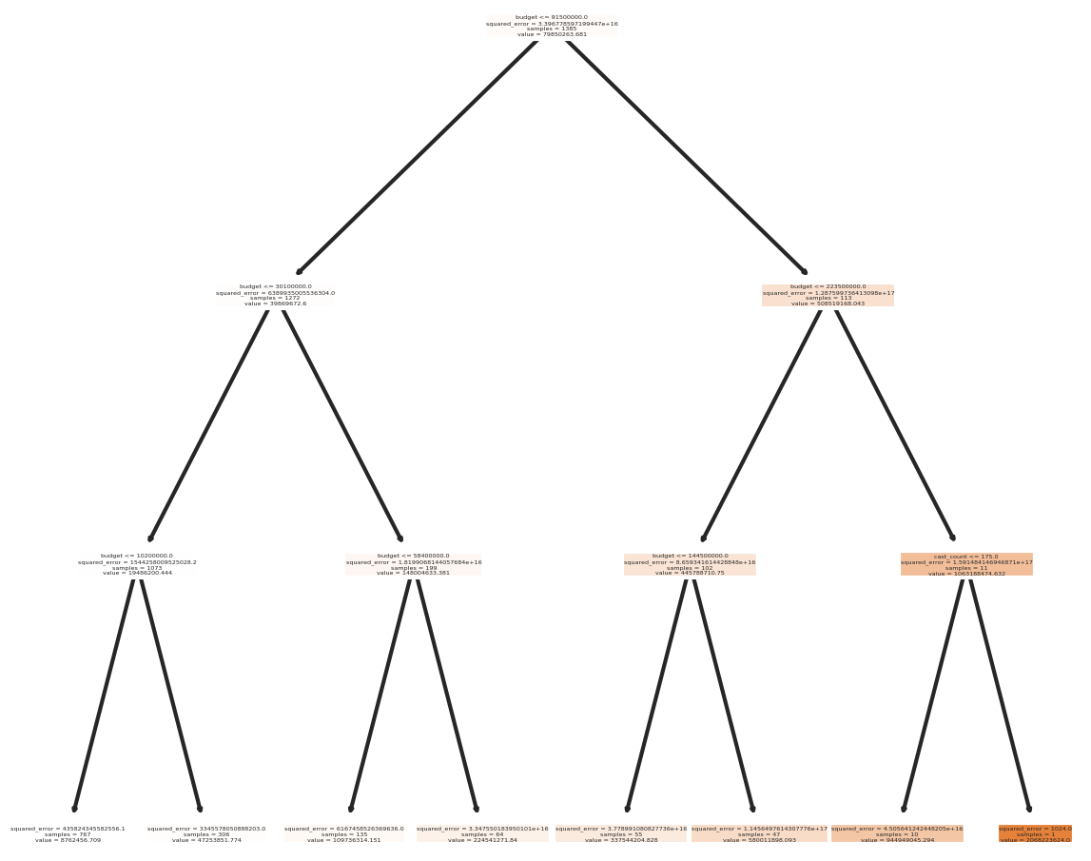
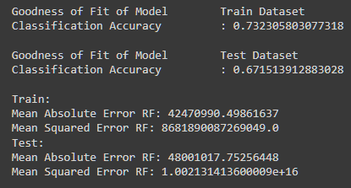
Random Forest Tree
Set max depth to 3
Increasing depth did not improve accuracy much
Notes:
The Random forest regression was used because it can handle continuous variables and categorical variables which exists in our dataset. The depth of the random forest has be set to 3 as increasing the depth did not seem to improve accuracy.
The first tree generated by the random forest model can be seen on the left.
Random forest yield a accuracy of 0.73 using our train values, and dropped to 0.67 when testing with our test values. The accuracy between the train and test dataset may be due to random forest being unable to discover trends that would enable it in extrapolating values that fall outside the training set. Thus, we wanted to try a multivariate linear regression to see how a linear regression may perform.

Slide 23
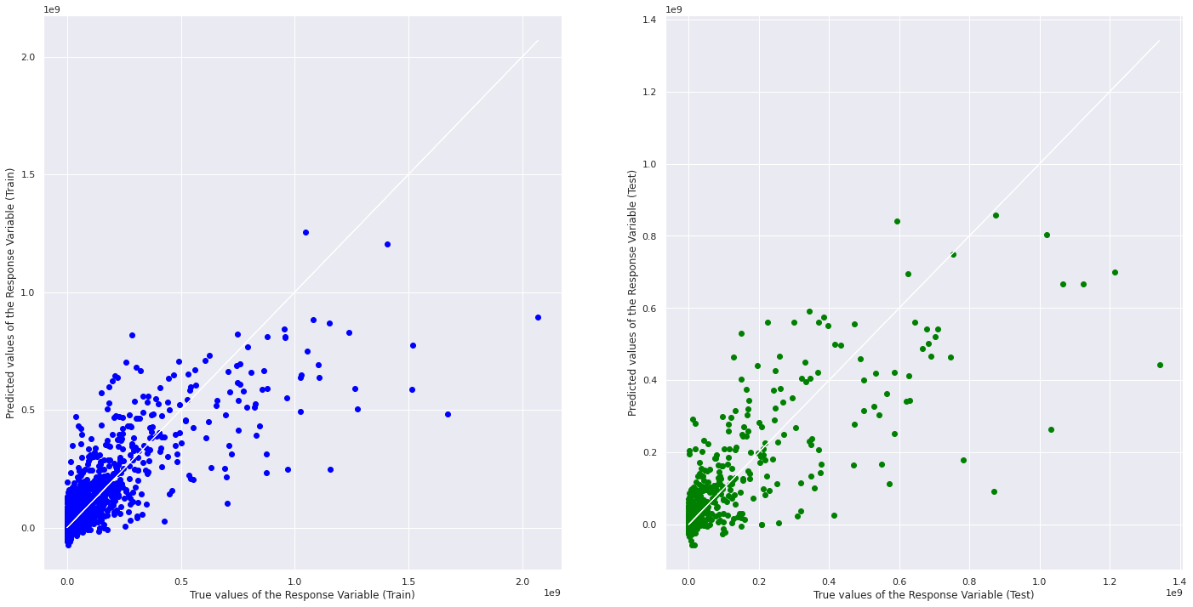
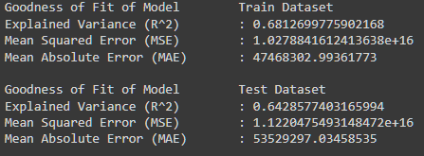
Linear Regression
Train vs test
Notes:
In the multivariate linear regression, The accuracy of our train dataset is 0.68 and dropped to 0.64 when using our test dataset. This is a less significant drop as compared to random forest model. However the R^2 is still not ideal. Therefore, we wanted to try XGBoost model, as it has been gaining popularity among competitors in data science.

Slide 24
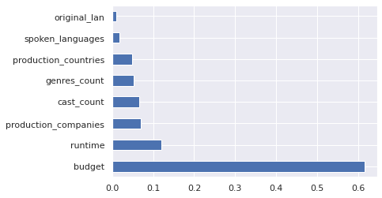
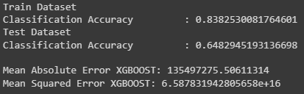
XGBoost
Features importance
Notes:
In XGBoost model, the features importance graph provides a score that shows how useful each feature was during the construction of the boosted decision tree within the model. The budget variable as shown in the chart has the highest relative importance used by the model to make key decisions within the decision tree.
The accuracy of XGBoost with train dataset starts with 0.83 and dropped to 0.64 when using the test dataset. The accuracy between the train and test is quite significant. XGBoost model did not yield a significant change in our test accuracy.

Slide 25
 | Random Forest Model |  | Linear Regression |  | XGBoost
 | Train | Test | Train | Test | Train | Test
Classification Accuracy | 0.732 | 0.671 | 0.68 | 0.64 | 0.84 | 0.62
MAE | 42470990 | 48001018 | 47468303 | 53529297 | 34282022 | 48389736
MSE | 8.682E+15 | 1.002E+16 | 1.028E+16 | 1.122E+16 | 5.156E+15 | 1.185E+16
Notes:
This table shows the classification accuracy, Mean absolute error, Mean Squared Error for all three of our models.

Slide 26
Classification Accuracy - Test
Random Forest 0.67
Multivariate Linear regression 0.64
XGBoost Model 0.62
0.62
0.64
0.66
0.68
Notes:
The table can be simplified by this bar chart comparing the test classification accuracy for all three models

Slide 27
CONCLUSION
05

Slide 28
CONCLUSION
What did we learn?
Random Forest Regression
XGBoost
Project Outcomes and Conclusions:
Predict revenue of a movie based on factors during the making of the movie.
Random forest and Multivariate linear regression did give most similar accuracy, however linear regression accuracy was most similar in train and test.
Data-driven insights and recommendations:
July as a release month brings in high revenue.
Including elements of action, adventure, history, fantasy in the story of the movie will be beneficial as those genres have shown to generate high revenues.
Keeping the runtime within a 50-150 minutes range, is optimal in ensuring high revenues.
Popularity has a moderately strong correlation with revenue, therefore, movie producers should make an effort to market their movie well so that its popularity is high.
Including actors with a consistently successful work performance in the movie, may enhance the chances of generating a higher revenue.
Notes:
Our team learned two new machine learning models, Random Forest Regression and Extreme Gradient Boost
In the end, our model will help movie makers predict revenue of a movie based on factors during the making of the movie such as the number of casts or the budget.
In conclusion, XGBoost model yield the highest train accuracy, the random forest yields the highest test accuracy. The multivariate linear regression model has the most consistent accuracy between the train and test dataset.
Additionally, the moderate accuracy score our models gave may be attributed to movies not releasing their budget and revenue information, our 140k rows has been reduced to 2747 rows. The smaller dataset may influence the accuracy of our models.

Slide 29
CONCLUSION
Data-driven insights and recommendations:
July as a release month brings in high revenue.
Including elements of action, adventure, history, fantasy in the story of the movie will be beneficial as those genres have shown to generate high revenues.
Keeping the runtime within a 50-150 minutes range, is optimal in ensuring high revenues.
Popularity has a moderately strong correlation with revenue, therefore, movie producers should make an effort to market their movie well so that its popularity is high.
Including actors with a consistently successful work performance in the movie may enhance the chances of generating a higher revenue.
Notes:
These are some of the insights we gained from our data and some recommendations towards the target problem, based on our analysis
July as a release month, brings in high revenue
Including elements of action, adventure, history, or fantasy in the story of a movie will be beneficial as those genres have shown to generate high revenues.
Keeping the runtime within a 50-150 minutes range, is optimal in ensuring high revenues.
Popularity has a moderately strong correlation with revenue, therefore, movie producers should make an effort to market their movie well so that its popularity is high.
Including actors with a consistently successful performance in the movie may enhance the chances of generating a higher revenue

Slide 30
THANK YOU!

Slide 31
References
Derrick M. (2021 October 26). Random Forest Regression: When Does It Fail and Why? Neptune Blog. https://neptune.ai/blog/random-forest-regression-when-does-it-fail-and-why
Berna B. (n.d). EDA & Random Forest & XGBoost - TMDB Box Office. Kaggle. https://www.kaggle.com/code/bernabas/eda-random-forest-xgboost-tmdb-box-office
Sruthi E R. (2021 June 17). Understanding Random Forest. Analytics Vidhya. https://www.analyticsvidhya.com/blog/2021/06/understanding-random-forest/#:~:text=Random%20forest%20is%20a%20Supervised,average%20in%20case%20of%20regression.
XGBoost (n.d). XGBoost Documentation. https://xgboost.readthedocs.io/en/stable/
The Movie Database (n.d). The Movie Database website. https://www.themoviedb.org/

